Slide 1



A
Synopsis Presentation
On
“Share-A-bite”
At
Goel Institute Of Higher Studies Mahavidyalaya
BCA -6th sem
Session 2023-24
Under Guidance Of :
Presented By :
Mr. Arun Singh Yadav
Manshi Shukla
Assistant Professor
2111640580034
GIHS Mahavidyalaya

Slide 2
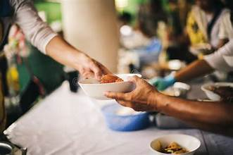
Share-A-bite
Presented by-
Manshi Shukla

Slide 3


TABLE OF CONTENT
Introduction
Background
Existing System
Problem Statement
Objectives
Propose System
System Diagram
Conclusion
Bibliography
Future Scope

Slide 4
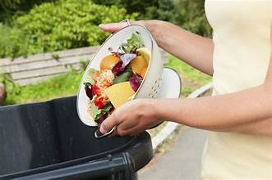
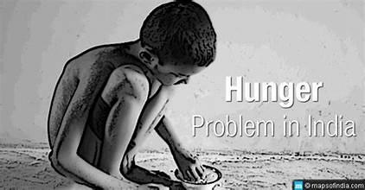
INTRODUCTION
In a world where millions go hungry every day, and yet vast amounts of food are wasted the need for innovative solutions to bridge this gap. It is estimated that approximately one-third of all food produced for human consumption is wasted globally each year, amounting to a staggering 1.3 billion tonnes.
In response to this critical issue, I want to make a website on which anyone can give food to needy people or those who have an actual need for food if they have more than sufficient food.

Slide 5
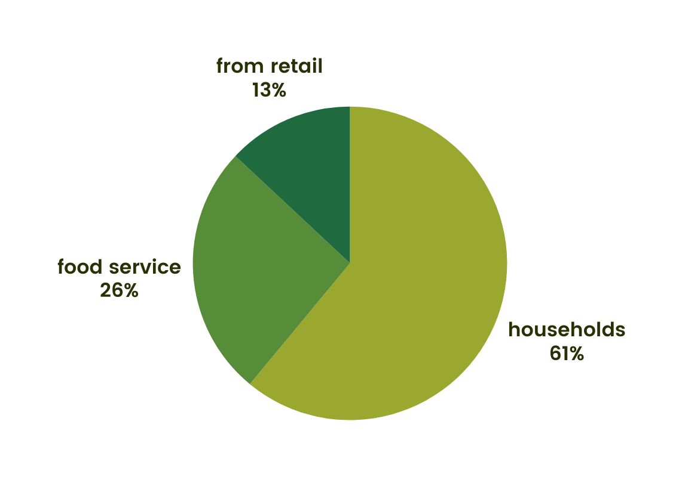
Background
ACCORDING TO UNEP:
This report estimates that around 931 million tonnes of food waste was generated in 2019.
·61% of which came from households, 26% from food service and 13% from retail.

Slide 6
EXISTING SYSTEM
There are some food donation websites run in the market like-
aahar -
Aplication
india foodBank networking
donateinkind
But on the above website, you cannot donate your food directly you can donate rupees only. The Aahar app does not work smoothly and this is only for specific areas.

Slide 7

PROBLEM STATEMENT
Food waste is a prevalent issue while many individuals battle hunger.
Current donation solutions lack robustness and efficiency.
Donations often go directly to individuals, missing the potential for broader impact.
There's a need to connect donors with organizations and then individuals.
Bridging this gap requires a system to facilitate the sharing of excess food.

Slide 8
OBJECTIVES
“Share-A-Bite” is to significantly reduce food wastage by facilitating the donation of surplus food from businesses, events, and individuals.
Our project objective is to bridge the gap between food donors and needy people (or hungry people)
To provide nutritious meals to individuals and communities in need.
To raise awareness about food insecurity and the importance of food donation.

Slide 9
SYSTEM FEATURES
User Registration and Profiles
Easy Donation Listing
Recipient Search and Requests
Real-Time Communication

Slide 10
PROPOSED SYSTEM
Share-A-bite is a web platform connecting donors with needy people. Donors can easily list their excess food, while the needy can search and request food based on location. Real-time communication tools and user verification features ensure a safe and efficient food donation experience.
So, there are the highlighted points-
Food Listings
Search and Filter
Scheduling
Communication
Verification and Safety
Feedback and Reviews

Slide 11
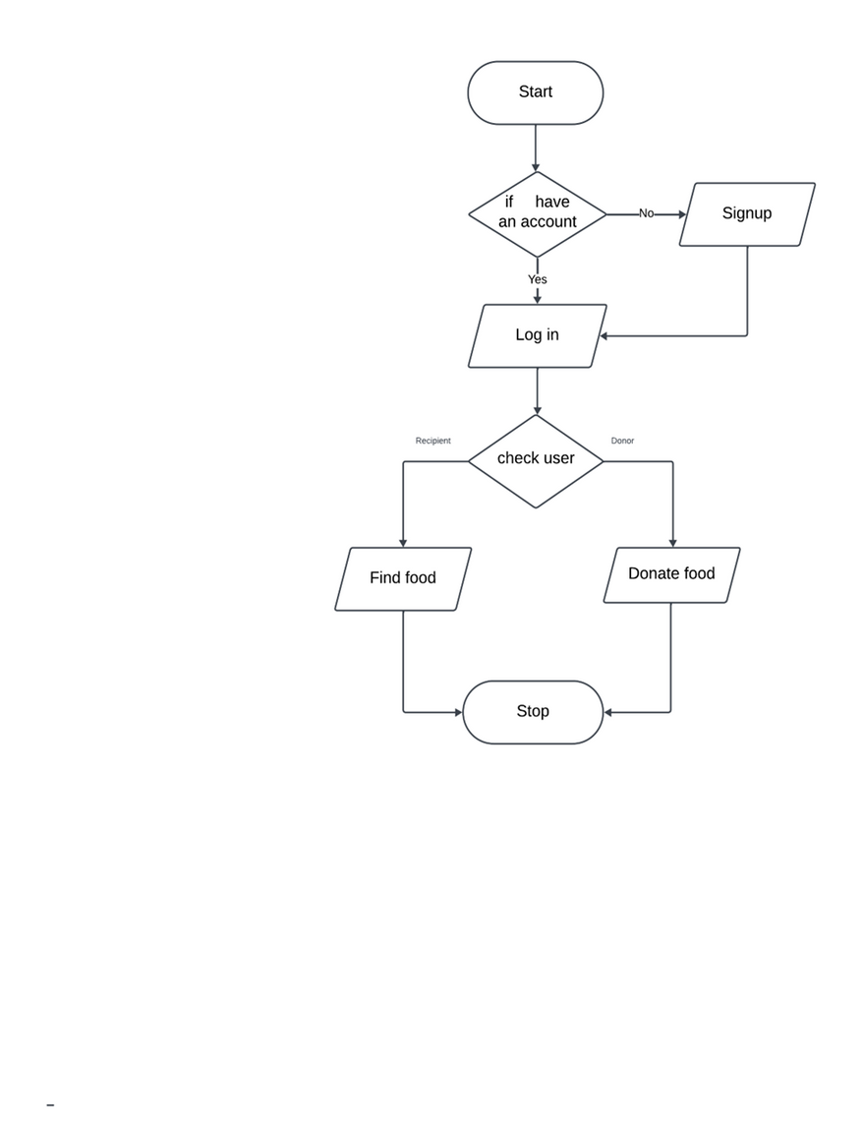
SYSTEM DIAGRAM

Slide 12
CONCLUSION
There is a large amount of food that is wasted every year and millions of people die because of food .and the existing system provides services for donating rupees, not food directly, and is not robust enough. So I want to create such a website or platform on which anyone can give food to hungry people or those who have an actual need for food if they have more than sufficient food and a needy person who wants to access this food they can access easily.
it is a way to help people who are struggling with poverty and hunger, and it can also help to reduce food waste. So basically I want to create a website that will bridge the gap between donors and needy people.
2020
2021
2022
work
award
work
award
work
award

Slide 13
FUTURE SCOPE
1. Expansion of Geographic Reach:
2. Enhanced Mobile Accessibility:
3. Integration of Advanced Technologies:
4. Diversification of Food Donations:

Slide 14
BIBLIOGRAPHY
Web reference-
https://www.donateinkind.in/leftover-food-donation
https://www.nofoodwaste.org/donation-new.html
https://www.indiafoodbanking.org/about/ https://robinhoodarmy.com
https://youtu.be/VtRdpXCgP-g?si=YxVQB5lC7ESuBE9e

Slide 15



THANKS YOU

